Slide 1

Mensuration
Placement Preparation
Aptitude & Reasoning
Prof. Krunal D. Vyas
Computer Engineering Department
krunal.vyas@darshan.ac.in
9601901005

Slide 2
Introduction
Mensuration deals with the study of different geometrical shapes, their area and volume.
It is based on the use of algebraic equations and geometric calculations to provide measurement data regarding the width, depth and volume of a given object or group of objects.
There are two types of geometric shapes:
1) Two – dimensions (2D) shape: It has area and perimeter.
2) Three – dimensions (3D) shape: It has volume and surface area.

Slide 3
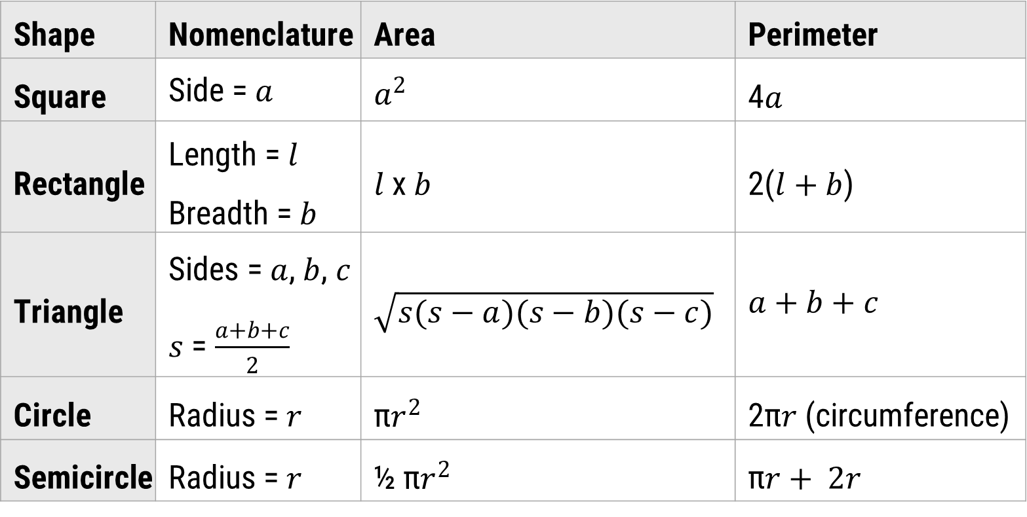
Two – dimensions (2D)
Shape | Nomenclature | Area | Perimeter
Square | Side = $a$ | $$a^{2}$$ | 4$a$
Rectangle | Length = $l$ Breadth =$b$ | $l$ x$b$ | 2($l+b$)
Triangle | Sides = $a$, $b$, $c$ $s$ = $\frac{a+b+c}{2}$ | $$\sqrt{s(s−a)(s−b)(s−c)}$$ | $$a+b+c$$
Circle | Radius = $r$ | π$r^{2}$ | 2π$r$ (circumference)
Semicircle | Radius = $r$ | ½ π$r^{2}$ | π$r+ 2r$

Slide 4
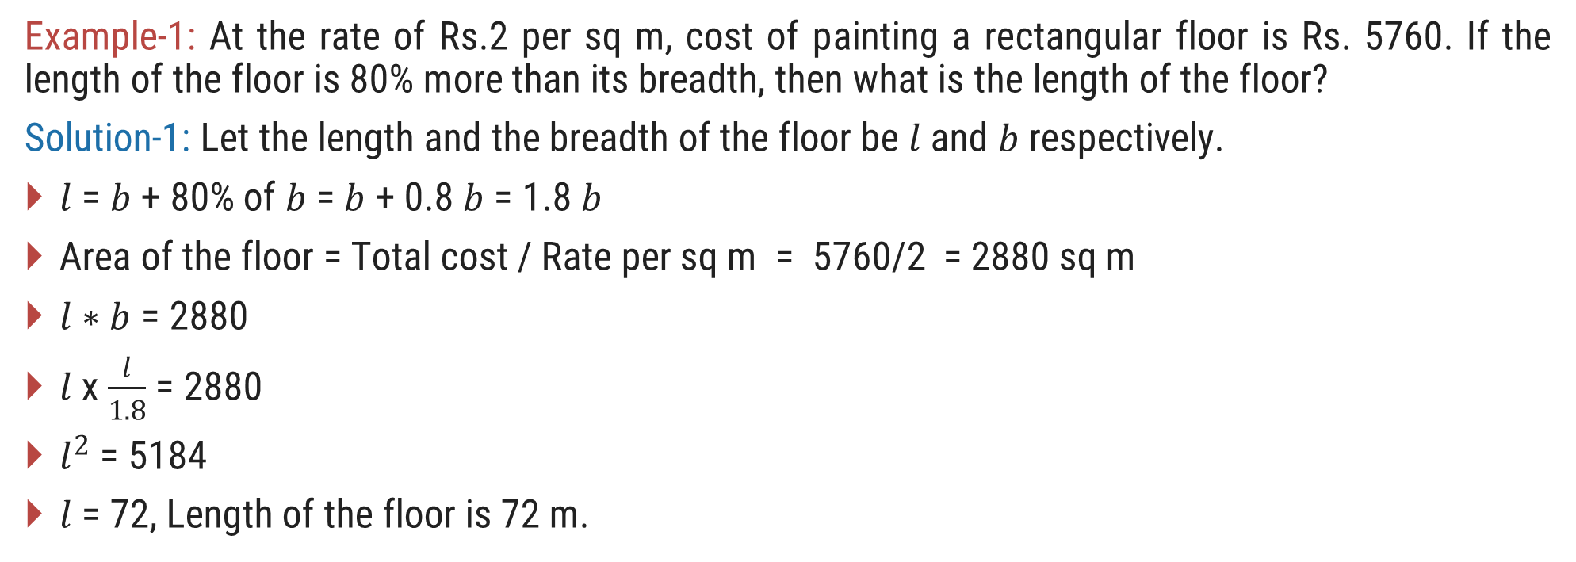
Two – dimensions (2D) Examples
Example-1: At the rate of Rs.2 per sq m, cost of painting a rectangular floor is Rs. 5760. If the length of the floor is 80% more than its breadth, then what is the length of the floor?
Solution-1: Let the length and the breadth of the floor be $l$ and $b$ respectively.
$l$ = $b$ + 80% of $b$ = $b$ + 0.8$b$ = 1.8 $b$
Area of the floor = Total cost / Rate per sq m = 5760/2 = 2880 sq m
$l∗b$ = 2880
$l$ x $\frac{l}{1.8}$ = 2880
$l^{2}$ = 5184
$l$ = 72, Length of the floor is 72 m.

Slide 5
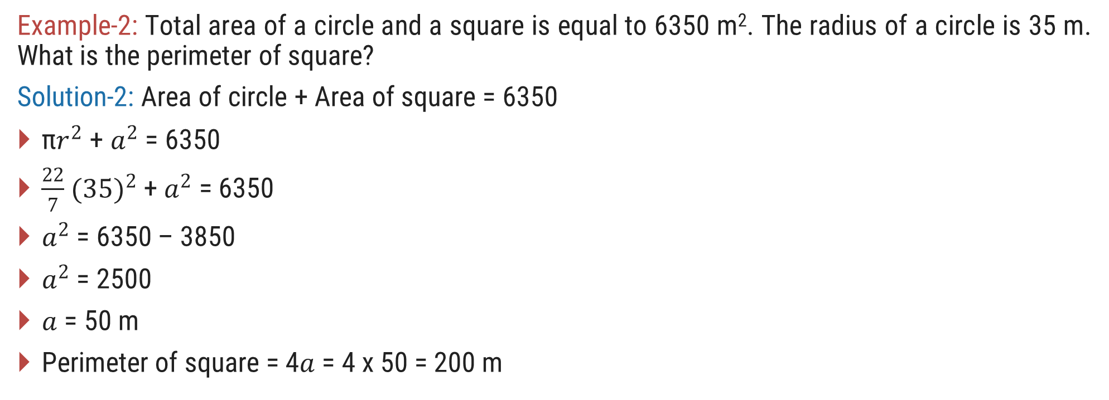
Two – dimensions (2D) Examples
Example-2: Total area of a circle and a square is equal to 6350 m². The radius of a circle is 35 m. What is the perimeter of square?
Solution-2: Area of circle + Area of square = 6350
π$r^{2}$ + $a^{2}$ = 6350
$\frac{22}{7}$ ${(35)}^{2}$ + $a^{2}$ = 6350
$a^{2}$ = 6350 – 3850
$a^{2}$ = 2500
$a$ = 50 m
Perimeter of square = 4$a$ = 4 x 50 = 200 m

Slide 6
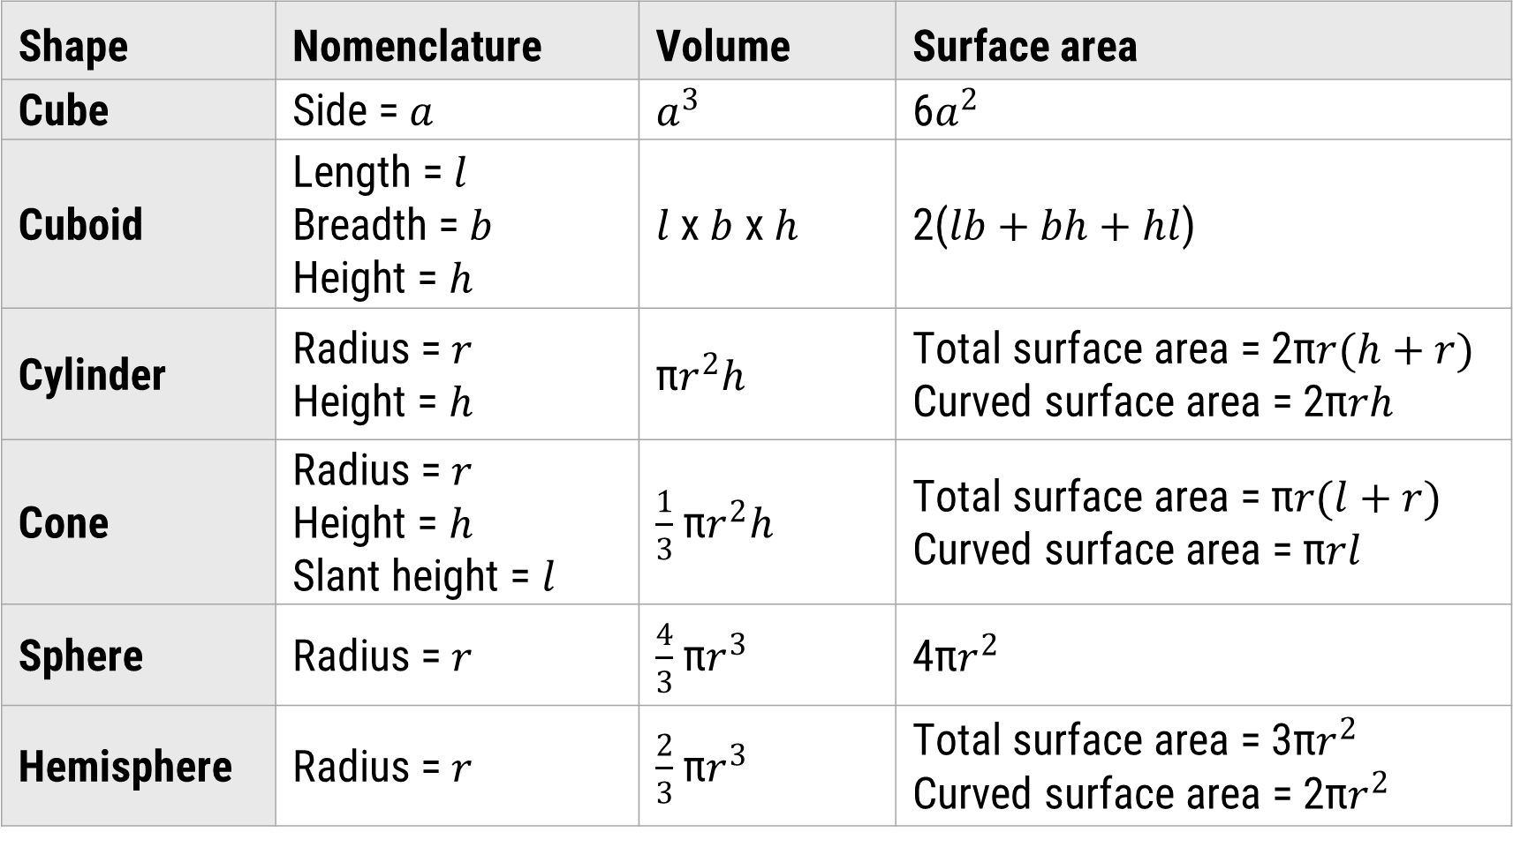
Three – dimensions (3D)
Shape | Nomenclature | Volume | Surface area
Cube | Side = $a$ | $$a^{3}$$ | 6$a^{2}$
Cuboid | Length = $l$ Breadth =$b$ Height = $h$ | $l$ x$b$ x $h$ | 2($lb+bh+hl$)
Cylinder | Radius = $r$ Height = $h$ | π$r^{2}h$ | Total surface area = 2π$r(h+r)$ Curved surface area = 2π$rh$
Cone | Radius = $r$ Height = $h$ Slant height = $l$ | $\frac{1}{3}$ π$r^{2}h$ | Total surface area = π$r(l+r)$ Curved surface area = π$rl$
Sphere | Radius = $r$ | $\frac{4}{3}$ π$r^{3}$ | 4π$r^{2}$
Hemisphere | Radius = $r$ | $\frac{2}{3}$ π$r^{3}$ | Total surface area = 3π$r^{2}$ Curved surface area = 2π$r^{2}$

Slide 7
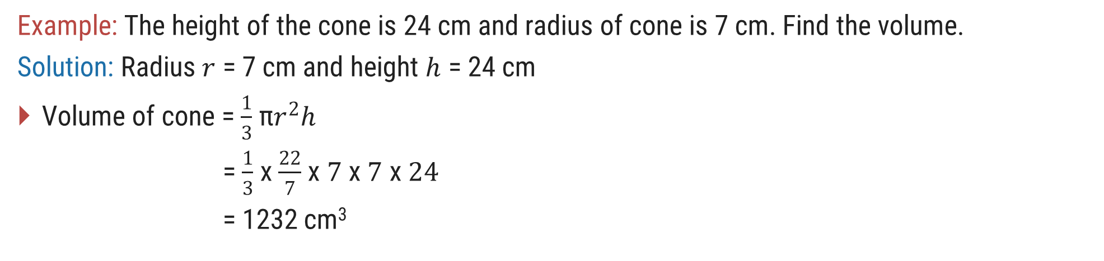
Three – dimensions (3D) Examples
Example: The height of the cone is 24 cm and radius of cone is 7 cm. Find the volume.
Solution: Radius $r$ = 7 cm and height $h$ = 24 cm
Volume of cone = $\frac{1}{3}$ π$r^{2}h$
= $\frac{1}{3}$ x $\frac{22}{7}$ x $7$ x $7$ x $24$
= 1232 cm³

Slide 8
Exercise
Ex-1: The perimeter of a square is 48 cm. The area of rectangle is 4 cm² less than the area of the square. If the length of the rectangle is 14 cm, then its perimeter is?
Ex-2: A tank is 25 m long, 12 m wide and 6 m deep. The cost of plastering its walls and bottom at 75 paise per sq. m is?
Ex-3: The capacity of a cylindrical tank is 246.4 liters. If the height is 4 meters, what is the diameter of the base?
Ex-4: Area of the canvas cloth needed to erect a right conical tent of height 12 ft and circular base having circumference 10∏ ft is?
Ex-5: How many lead shots each 3 mm in diameter can be made from a cuboid of dimensions 9 cm x 11 cm x 12 cm?
Ans = 48 cm
Ans = Rs. 558
Ans = 28 cm
Ans = 65∏ sq. ft
Ans = 84000

